Slide 1
Clarity
By Nisha Choudhary, Nadine Adnane, Viktoria Braun, Nitisha Bhandari, Faryal Khan, and Nigina Daniyarova

Slide 2
Clarity was born
Inspiration:
The power of education
Increasingly high interest for safe ingredients
Demand for skincare and makeup products
Enhance natural beauty
Natural ingredients
Ingredient Transparency

Slide 3

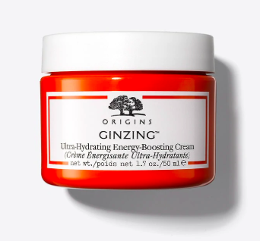

Slide 4
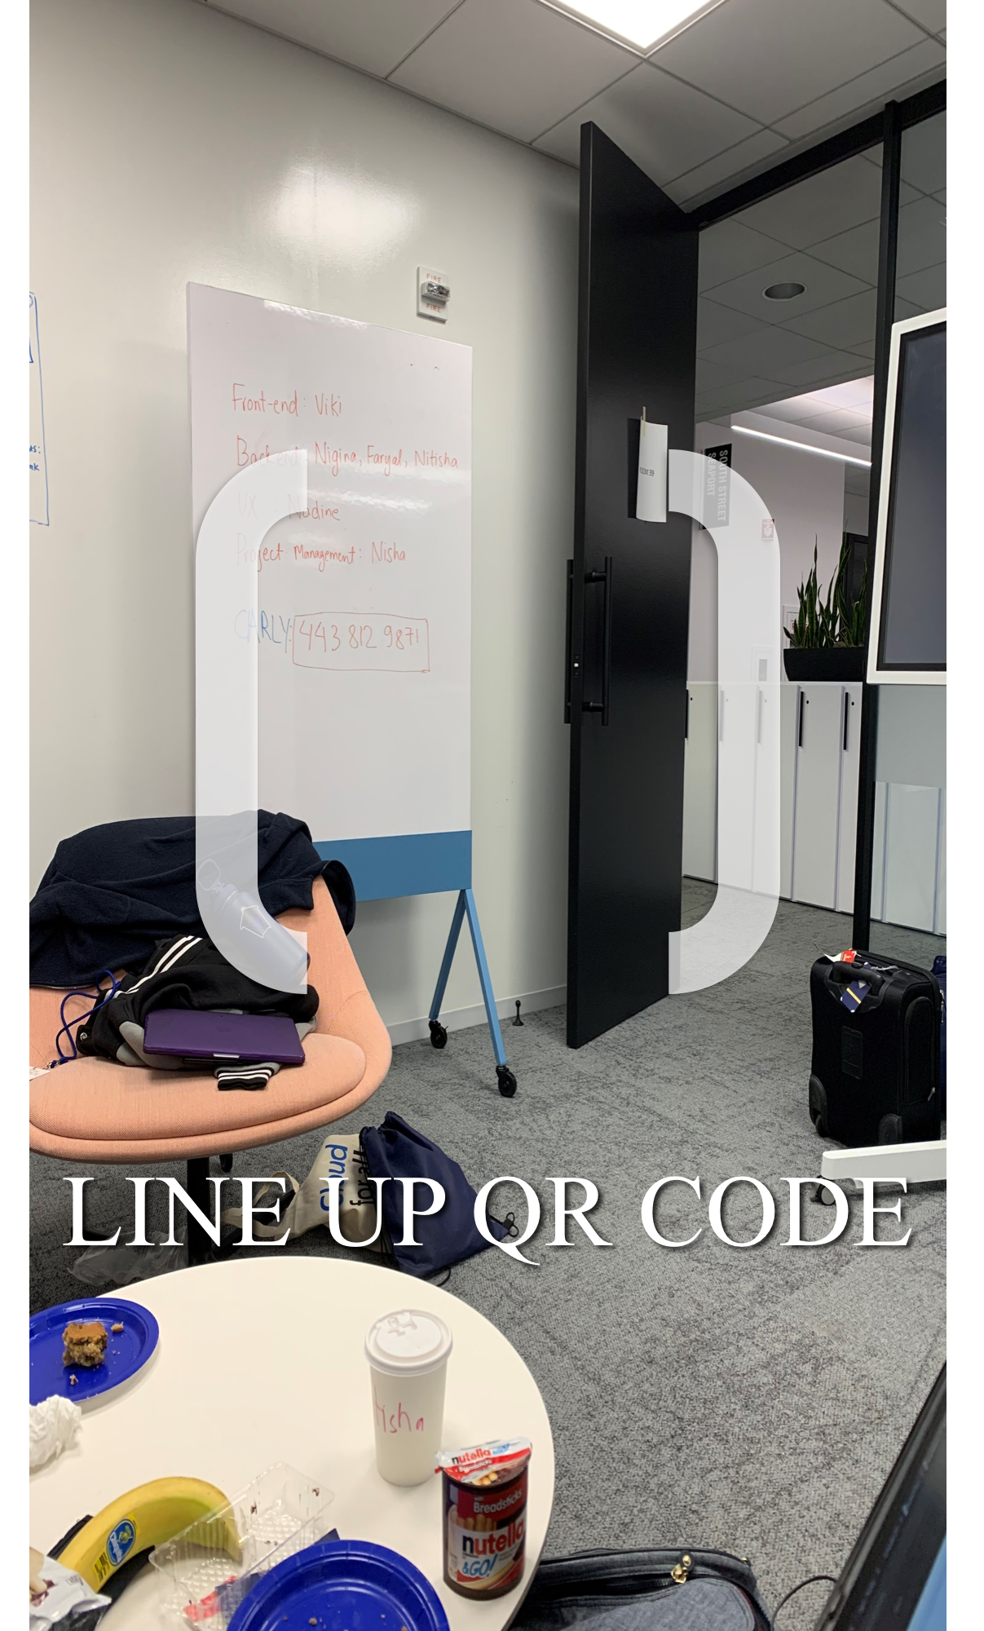

Slide 5
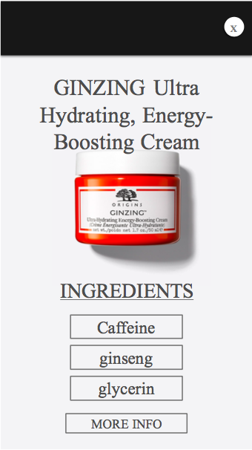

Slide 6
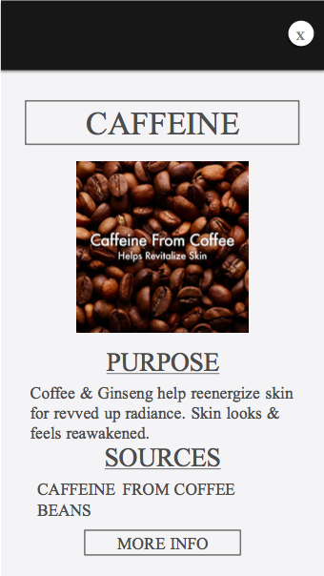

Slide 7
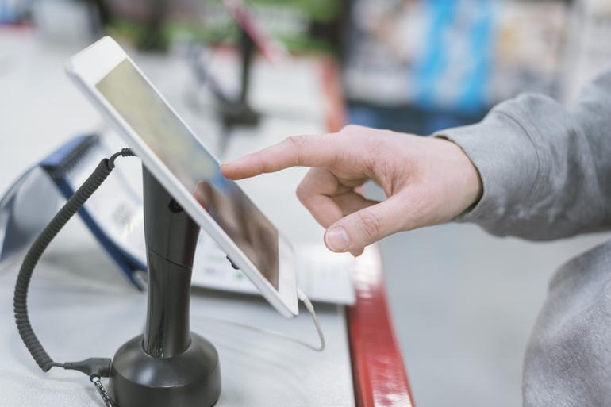
Applications
In-store technology on a counter
Future feature of browsing by product available on mobile devices

Slide 8

Next Steps
Creating a database with all products’ information
Expand to products of all ELC subsidiaries
Dynamically make ingredients’ cards
Browsing products in the app

